Slide 1
Monitors (Hoare and P.B. Hansen; 1974)
A high-level synchronization construct that allows sharing of an abstract data type among concurrent processes.
Only one active process at a time inside the monitor!
type monitor-name = monitor variable declarations procedure entry PR₁ ( ... ) begin ... end; procedure entry PR₂ ( ... ) begin ... end; … procedure entry PR_{n} ( ... ) begin ... end; begin initialization code end.

Slide 2
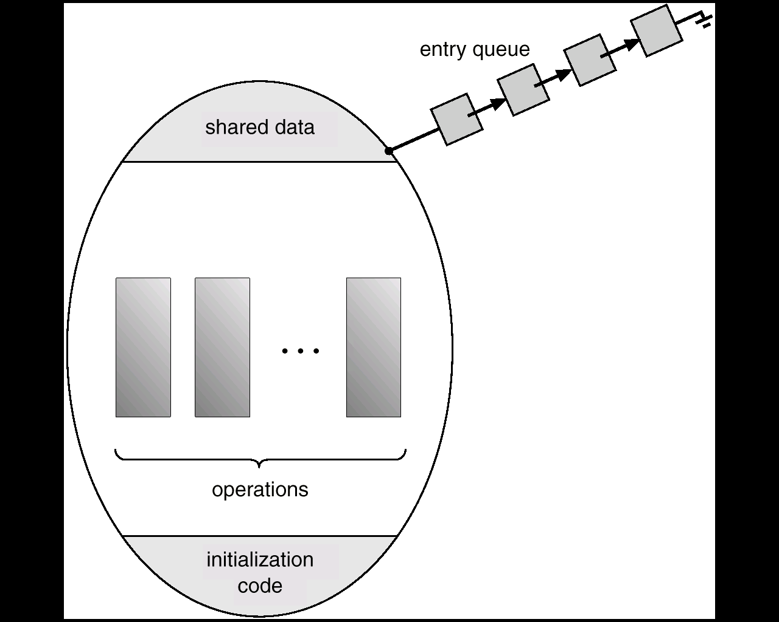
Schematic View of a Monitor

Slide 3
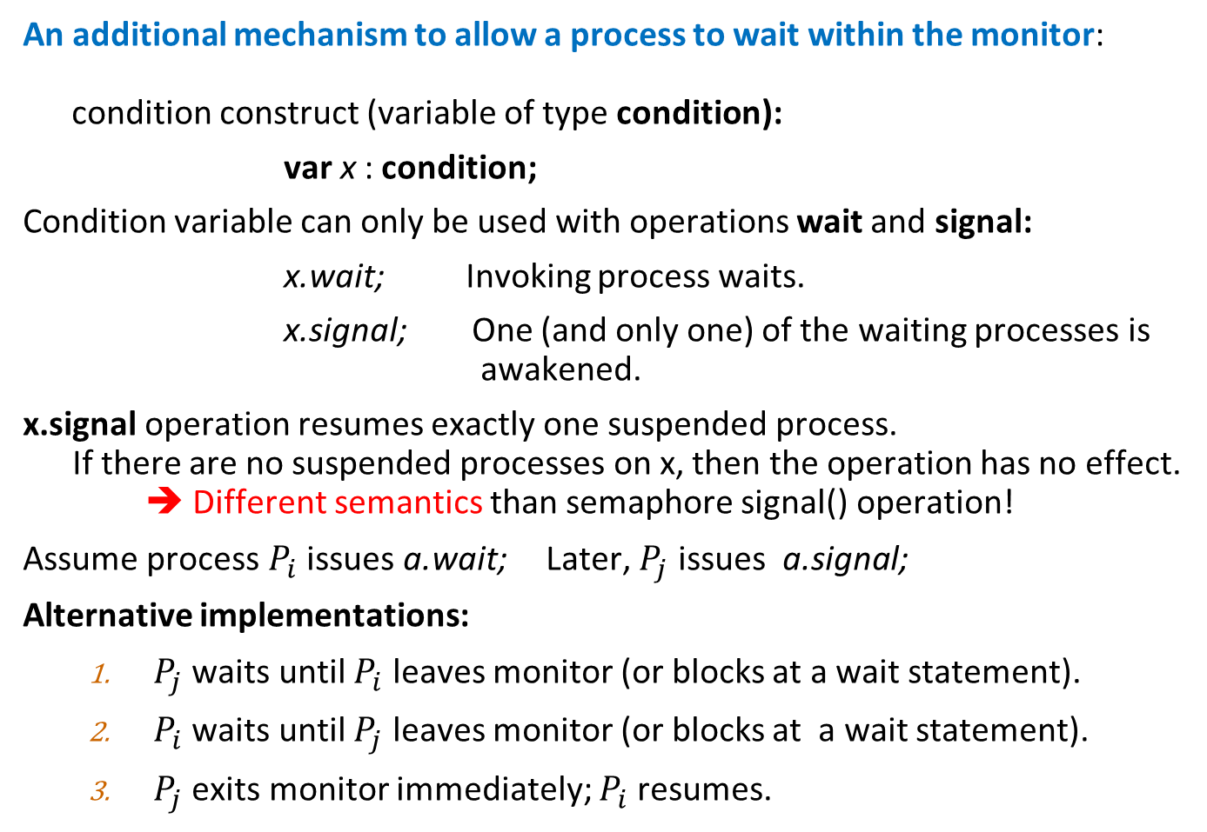
Condition Variables
An additional mechanism to allow a process to wait within the monitor: condition construct (variable of type condition):
var x : condition;
Condition variable can only be used with operations wait and signal:
x.wait; Invoking process waits.
x.signal; One (and only one) of the waiting processes is awakened.
x.signal operation resumes exactly one suspended process. If there are no suspended processes on x, then the operation has no effect. ➔ Different semantics than semaphore signal() operation!
Assume process $P_{i}$ issues a.wait; Later, $P_{j}$ issues a.signal;
Alternative implementations:
$P_{j}$ waits until $P_{i}$ leaves monitor (or blocks at a wait statement).
$P_{i}$ waits until $P_{j}$ leaves monitor (or blocks at a wait statement).
$P_{j}$ exits monitor immediately; $P_{i}$resumes.

Slide 4
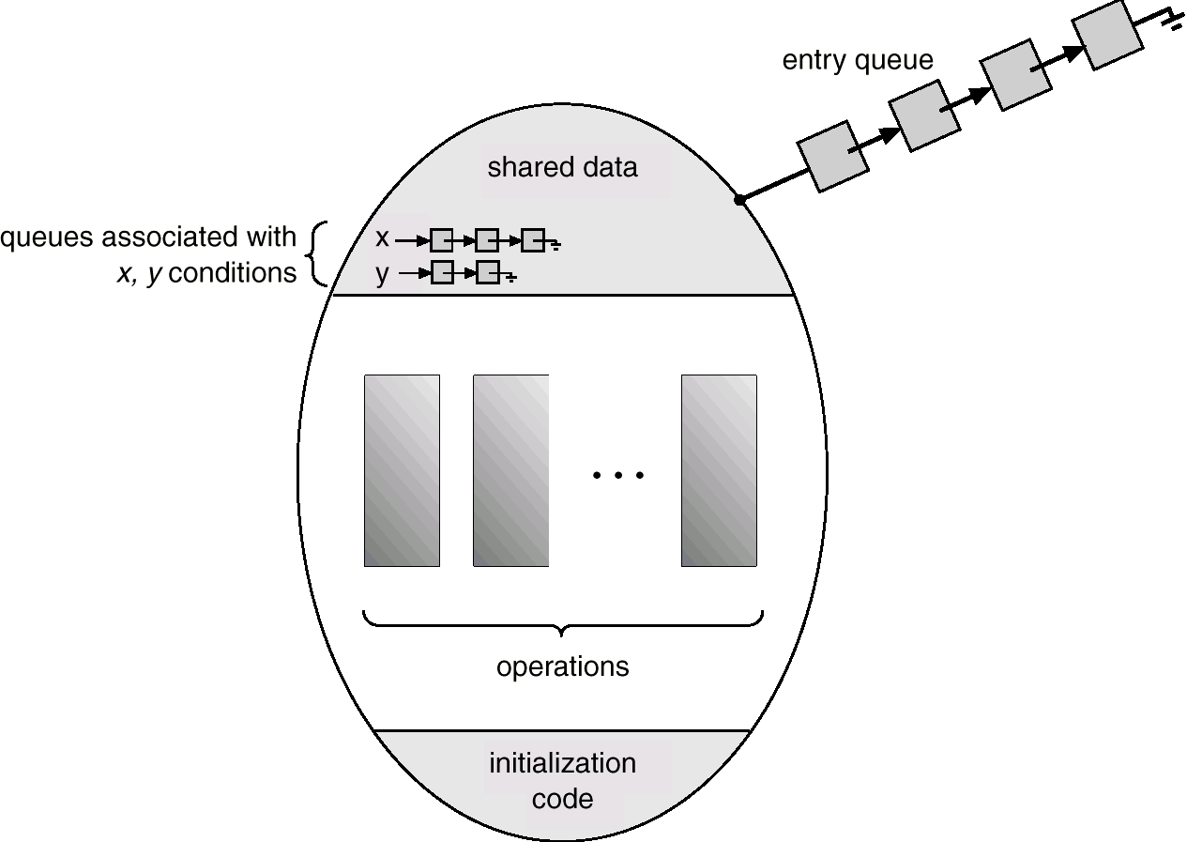
Monitor with Condition Variables

Slide 5
2013 Asgmnt 3: The H₂O Production Problem
There are two kinds of processes, oxygen and hydrogen. To assemble water molecules, we have to create a barrier that makes each process wait until a complete molecule is ready to proceed.
We don’t have to worry about matching the processes up explicitly; that is, the processes do not necessarily know which other processes they are paired up with.
Note that:
If an oxygen process arrives at the barrier when no hydrogen processes are present, it has to wait for two hydrogen processes.
If a hydrogen process arrives at the barrier when no other processes are present, it has to wait for an oxygen process and another hydrogen process.
Write a monitor-based solution to the H₂O production problem.

Slide 6
The H₂O Problem
type H2OMaker= monitor; //Type specification. var HCount:int; OCount: int; H:condition; O:condition; procedure OBarrier() procedure HBarrier() {OCount++; {HCount++; if (HCount≥2) if (OCount≥1 and HCount≥2) then {H.signal; H.signal} then {O.signal; H.signal} else O.wait; else H.wait; OCount−−} HCount--}
begin HCount:=0; OCount:=0 end. //Initialization. //End of type specification
Monitor Use: var MyH2OMaker: H2OMaker;
Oxygen process: {//GO-Barrier; MyH2OMaker.OBarrier(); //DONE}
Hydrogen process: {//GO-Barrier; MyH2OMaker.HBarrier(); //DONE}
Condition variable implementation alternative: After a signal, signaled process waits until the signaling process either exits the monitor, or blocks at a wait statement.

Slide 7
The Savings Account Problem
A savings account is shared by several people (i.e., processes). Each person may deposit or withdraw funds from the account. The current balance in the account is the sum of all deposits to date minus the sum of all withdrawals to date.
The balance must never become negative, and withdrawals are serviced First-Come-First-Serve with one twist: Those who want to withdraw money from the account are desperate to get their money; so, if the balance is not sufficient, they wait (in a FIFO order) until somebody else deposits enough money for them to make their withdrawals.
Note that those waiting for others to deposit (so that they can withdraw) are serviced strictly FIFO. For example, suppose the current balance is 200 dollars, and customer A is waiting to withdraw 300 dollars. Assume another customer, say B, arrives with the request of withdrawing 200 dollars. Customer B must wait until customer A is serviced.
Using monitors, give the algorithms for customers to withdraw or deposit funds.

Slide 8
The Savings Account Problem
type Account= monitor; //Type specification. var Balance:real; Need: real; First:condition; Later:condition; procedure Withdrawal(var W: real) procedure Deposit(var D: real) {if Need>0 Later.wait; {Balance:=Balance+D; if (Balance<W) if (Need>0) {Need:=W – Balance; First.wait} if (D ≥ Need) {Need:=0; First.signal} Balance:=Balance – W; else Need:=Need – D Later.signal} }
begin Balance:=200; Need:=0 end. //Initialization. //End of type specification
Monitor Use: var MyAccount: Account;
Withdrawal process: {//……; MyAccount.Withdrawal(300); //DONE}
Deposit process: {//…….; MyAccount.Deposit(200); //DONE}
Condition variable implementation alternative: After a signal, signaled process waits until the signaling process either exits the monitor, or blocks at a wait statement.

Slide 9
Expressive Power
Monitors and semaphores have the same expressive power. That is, if you can solve an algorithm with one, you can also solve it with the other one.
Why use monitors, then?
The next set of slides show that any monitor-based solution to a concurrent algorithm can be converted into a semaphore-based solution.

Slide 10
Implementing Monitors using Semaphores
This solution implements Alternative 1: signaling process waits until signaled process leaves monitor.
Initialization: semaphore mutex := 1; // enforces mutual exclusion. semaphore next := 0; // blocks signaling processes. int next‐count := 0; //count of blocked signaling processes. semaphore x‐sem := 0; //blocks the process that issues x.wait. int x‐count := 0; //count of processes that are blocked on x.wait.
Each monitor procedure PR() is implemented as:
wait (mutex); Body of PR; if next‐count > 0 then signal(next) else signal (mutex);
Mutual exclusion within a monitor is ensured.

Slide 11
Monitor Implementation Using Semaphores
x.wait implementation: x.signal implementation: x‐count := x‐count +1; if x‐count > 0 if next‐count > 0 then begin then signal (next) next‐count := next‐count + 1; else signal (mutex); signal(x-sem); wait (x‐sem); wait(next); x‐count := x‐count – 1; next‐count := next‐count – 1; end;
The process that issues “x.wait” waits on x‐sem.
x‐count keeps the count of processes waiting on x‐sem.
The process that executes “x.signal” waits on next, if necessary (alternative 1).

Slide 12
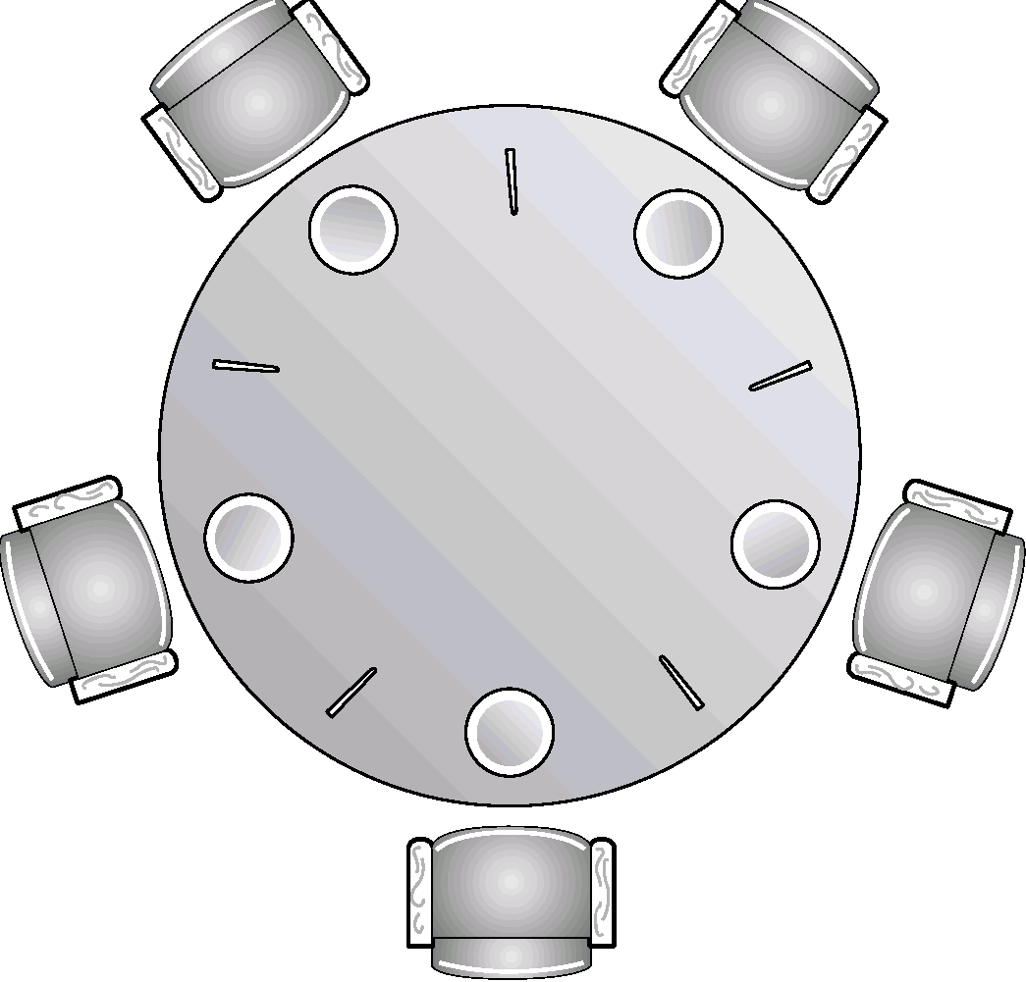
Dining Philosophers Problem (1965)
5 philosophers; 5 chopsticks; one bowl of rice.
var chopstick: array [0..4] of semaphore; /* All chopsticks are initialized to 1.

Slide 13
Dining Philosophers Problem
A philosopher eats or thinks!
Each philosopher needs two chopsticks to eat, and chopsticks are picked up one at a time.
After successfully picking up two chopsticks, a philosopher eats for a while, and, then, puts down the chopsticks, and thinks.
Problem: Decide how philosophers pick the chopsticks so that
Philosophers (processes) do not starve!
There is no deadlock.

Slide 14
Deadlock-Free Monitor-Based Solution to Dining Philosophers Problem
Type dining-philosophers = monitor var state : array [0..4] of (thinking, hungry, eating); var self : array [0..4] of condition; procedure entry pickup (i: 0..4); begin state[i] := hungry; test (i); if state[i ] ≠ eating then self[i ].wait; end; procedure entry putdown (i: 0..4); begin state[i] := thinking; test (i+4 mod 5); test (i+1 mod 5); end;

Slide 15
Deadlock-Free Monitor Solution to Dining Philosophers
procedure test (k: 0..4); begin if state[k+4 mod 5] ≠ eating and state[k] = hungry and state[k+1 mod 5] ≠ eating then begin state[k ] := eating; self[k ].signal; end;
end;
begin for i := 0 to 4 do state[i] := thinking; end.
MONITOR USE: var dp: dining-philosopher; … dp.pickup(i); EAT dp.putdown(i); … Can livelocks occur?

Slide 16
Allocating a Single Resource to Processes
We use the conditional-wait construct: x.wait(c); c: integer priority
type resource-allocation = monitor; var busy: boolean; x: condition;
procedure entry acquire(priority:integer); begin if busy then x.wait(priority); busy: = True; end;
procedure entry release; begin busy:= False; x.signal; // Among waiting processes, the process end; // with smallest priority is released.
begin busy:= False; end; // Initialization code
MONITOR USE: var R: resource-allocation; …..
R.acquire(5); ….. ACCESS RESOURCE R.release;

Slide 17
Summary: We have seen Three Process Synchronization Constructs
Semaphores
Critical region or conditional critical region statements—CCRs
Monitors
WARNING #1: NO MIXING OF THESE CONSTRUCTS in your algorithms!
Your concurrent process algorithm can only use ONE of the two constructs.
If your algorithm uses semaphores, it cannot use monitors.
If your algorithm uses monitors, it cannot use semaphores.
WARNING #2: ALWAYS USE THE SAME SYNTAX GIVEN IN SLIDES!!

Slide 18
Concurrent programming problems seen in class and recitations
Bounded buffer problem--- Study!
Readers-writers problem---Study!
Dining philosophers problem
H₂O problem
Savings Account problem
Single resource allocation problem
There are other problems (and their solutions) in previous years’ assignments:
Sleeping barber problem; Railroad crossing problem; daycare problem, Bus service problem, etc.

Slide 19
Java Synchronization
A lock and condition variable are in every Java object.
No explicit classes for locks or condition variables.
Every object is/has a monitor.
At most one thread can be inside an object’s monitor.
A thread enters an object’s monitor by
Executing a method declared “synchronized”.
Can mix synchronized/unsynchronized methods in same class.
Executing the body of a “synchronized” statement.
Supports finer-grained locking than an entire procedure.
Identical to the Modula-2 “LOCK (m) DO” construct.
Every object can be treated as a condition variable.
Object::notify() has similar semantics as X.signal() statement.

